Slide 2
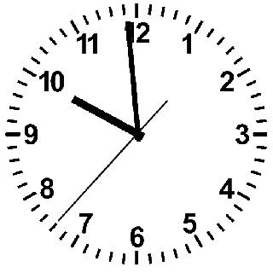
Sarcopenia
Notes:
The ticking of the clock never stops, every moment we get older, and one of the most striking effects of age is probably the involuntary loss of muscle mass, strength, and function. This is called Sarcopenia.

Slide 3
Computational approaches for the therapeutic target discovery to ame-liorate muscle wasting during aging and disease
M.Sc. Karen Guerrero Vazquez
Dr. Katarzyna Whysall
Dr. Pilib O Broin

Slide 4
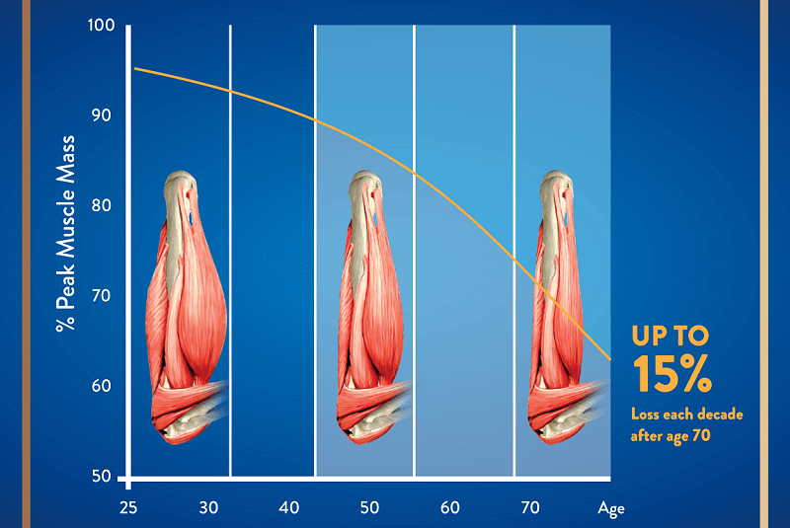
Notes:
. From the time you are born to around the time you turn 30, your muscles grow larger and stronger. But at some point in your 30s, you start to lose muscle mass and function. No matter the lifestyle, everybody is going to loss between 3 to 8% of muscle mass per decade after age 30, and this rate of decline is even higher after the age of 60. Sarcopenia is associated with detrimental clinical outcomes, such as a reduced quality of life, frailty, an increased risk of falls, fractures, hospitalization, and mortality.

Slide 5
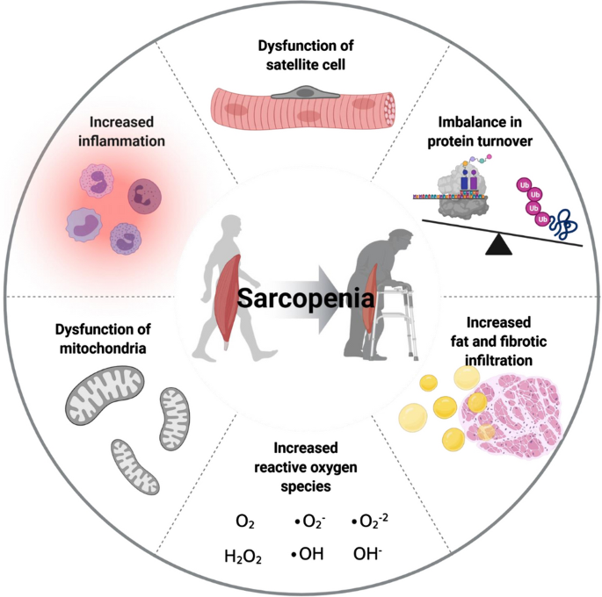
Yanai, 2020
Notes:
Several factors, including chronic inflammation, increased reactive oxidative species, increased fibrosis of muscle, and increased loss of motor neurons, have been reported to contribute to development of sarcopenia
Chronic inflammation
Increased reactive oxygen species
Increased fibrosis of muscle
Increased loss of motor neurons

Slide 6

Micro-RNA

Slide 7
non-coding RNAs
regulation of gene expression
14 and 33 nucleotides
Yanai, 2020
Notes:
Mircro RNA or miRNA are conserved small non-coding RNAs that play an important role in the regulation of gene expression, they are short nucleotide single stranded RNAs (ssRNAs), between 14 and 33, with an average of 20 as MirBase suggest today.

Slide 8
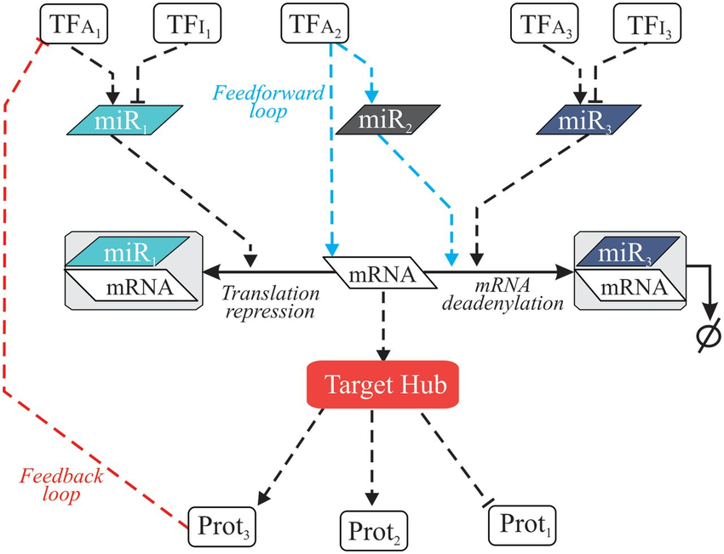
Regulatory Networks
Notes:
It is likely that miRNAs naturally build regulatory networks that control different cellular functions,

Slide 9
Regulatory Networks
Notes:
It is likely that miRNAs naturally build regulatory networks that control different cellular functions,
mathematical representation of a network and it describes the relationship between lines and points

Slide 10
There’s a computer representation of the microRNAs and their interaction that allows the identification of micro RNA for the treatment of Sarcopenia.

Slide 11
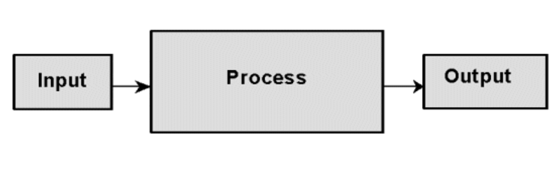
Computational model
?

Slide 12
1.- Define output
2.- Define inputs
3.- Define model

Slide 13
Objective
Localize micro RNA with potential as therapeutic for Sarcopenia
Small number (<20) miRNAs for further experimentation
Enough information to understand the working mechanism

Slide 14
Available input…
Available online repositories…
Own unpublished data on young and old
Muscle and primary cells in humans

Slide 15
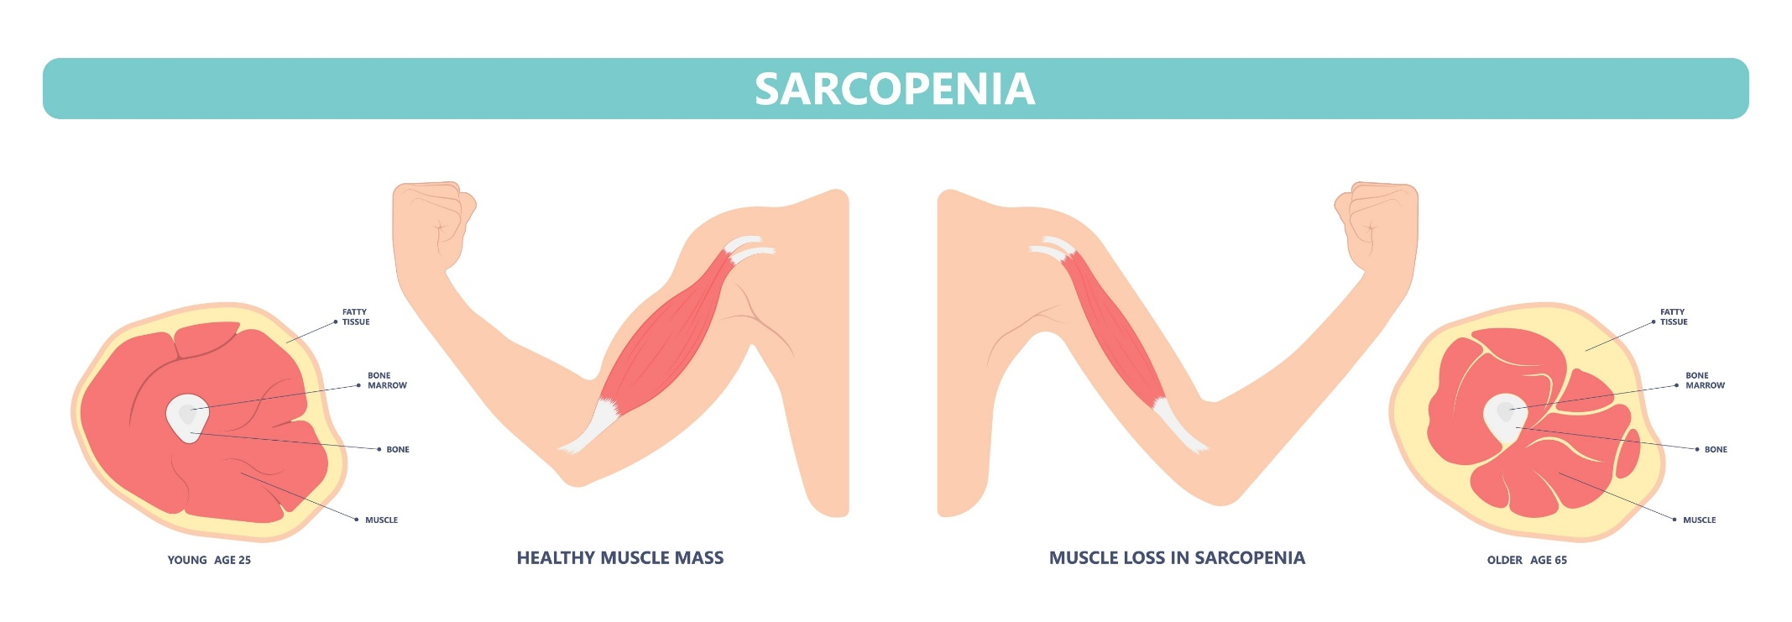
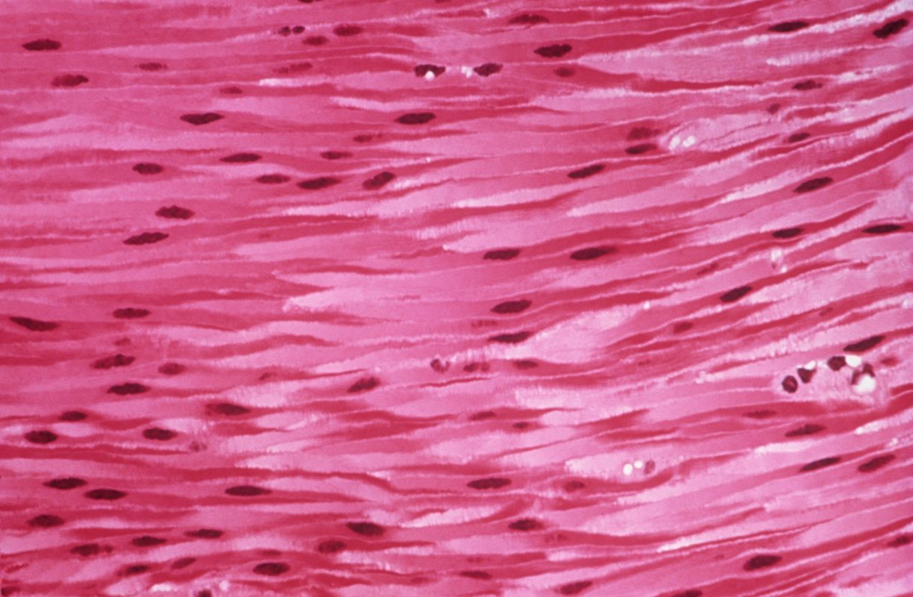
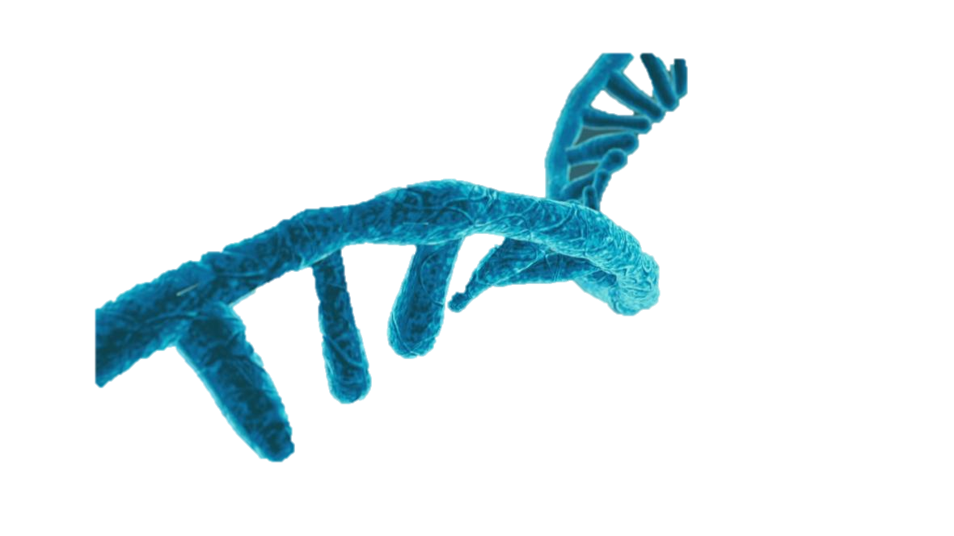
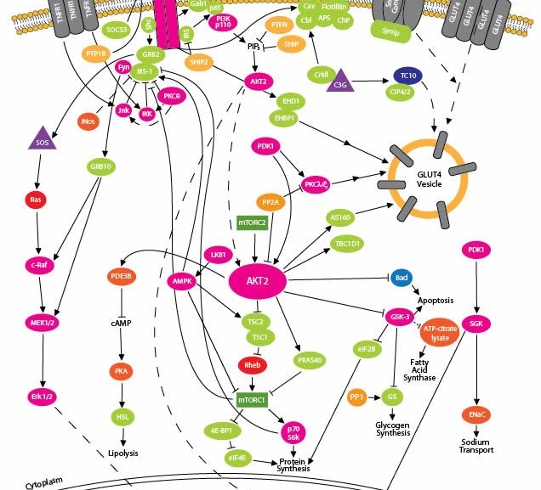

Slide 16

Notes:
We are swimming in a sea of data, the quality of the information is something that is currently under process, from the sources of the data to the value to the project. This will be tuned alongside the design of the network itself.

Slide 17
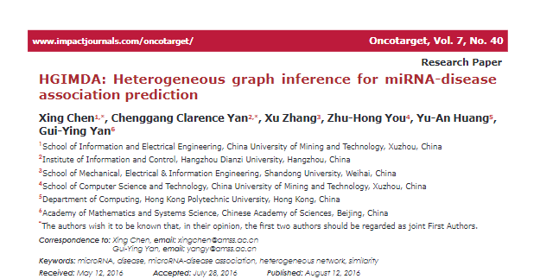
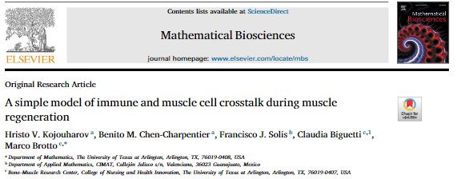
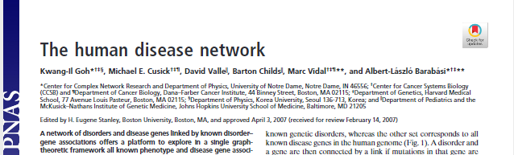
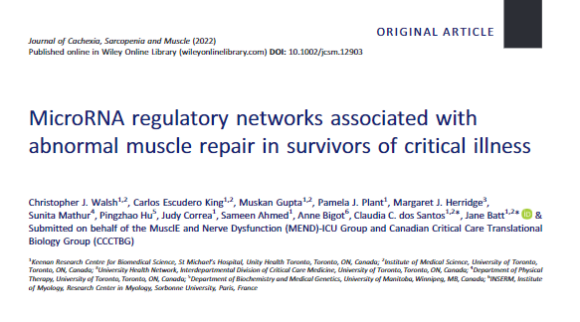
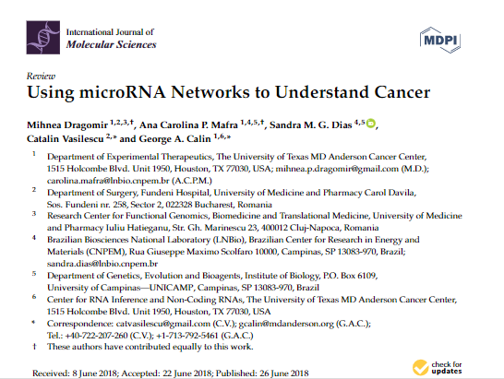
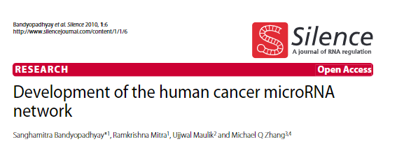
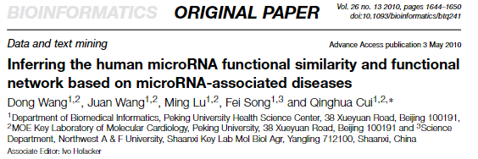
Notes:
Many works had been done in the past to find the influence of micro RNA in different diseases, appealing to different measures and rules.
Differential expression based vs unbias

Slide 18
Planned Methodology

Slide 19
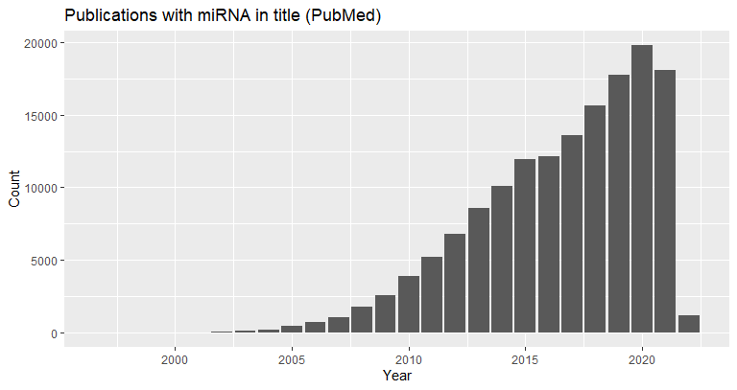



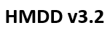



Data collection

Slide 20
Definition of the network
Rules
Relationship
Biological entity 1
Biological entity 2

Slide 21
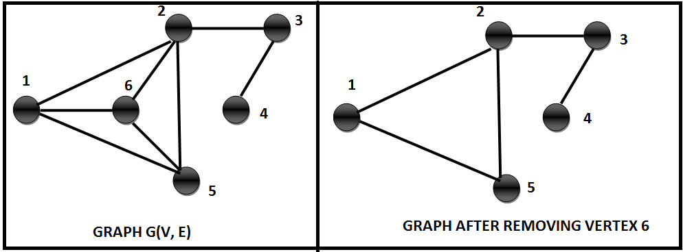

Graph operations
Similarity
Clusters
Centralities

Slide 22
Artifacts
Knowledge
Scale
Clear link
Tuning number of input nodes
High-throughput
Nonsense

Slide 23
Results

Slide 24

My own local database
+
=
24

Slide 25


Tool to standardize gene names
+
Gene names

Slide 26


Paper miner
Quick scan of literature
Selecting the best papers
Novelty (year)
Relevance (number of citations)
App Note

Slide 27
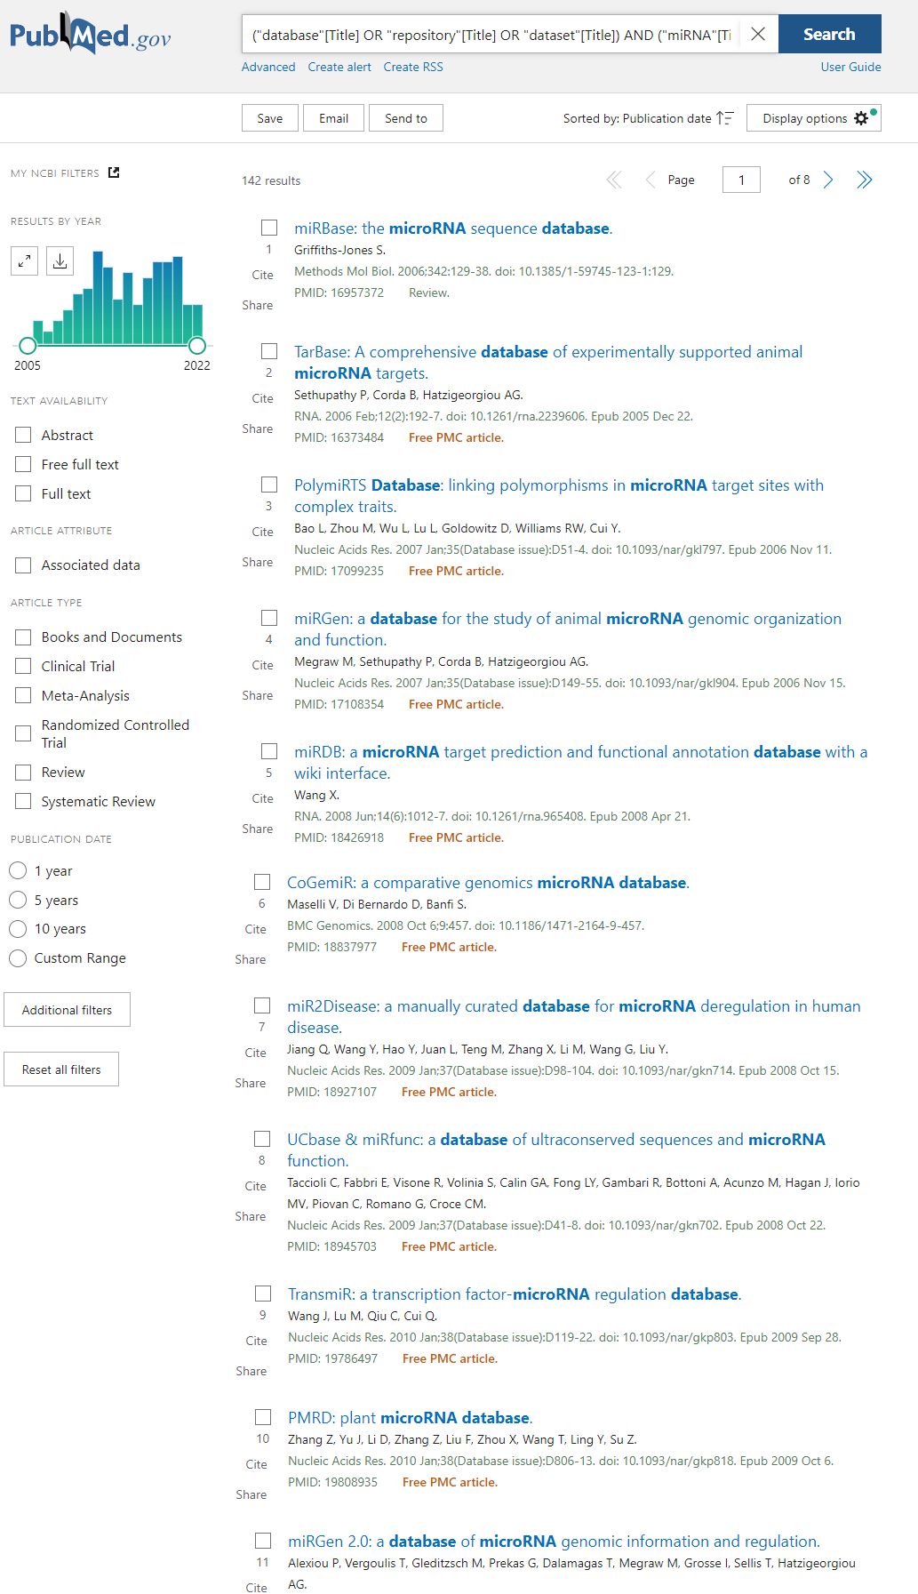
Year publication
Number of citations
Pubmed Query
List of “best” articles
Selection of the articles
("database"[Title] OR "repository"[Title] OR "dataset"[Title]) AND ("miRNA"[Title] OR "microRNA"[Title] OR "micro RNA"[Title])

Slide 28
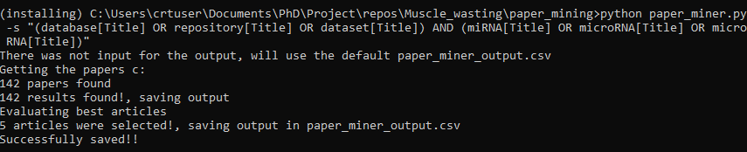
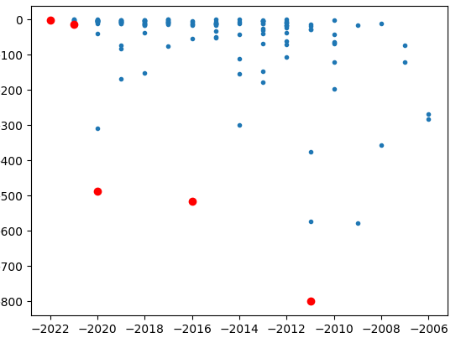
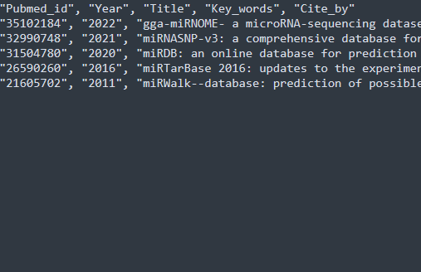

Slide 29
Immediate future work
Use Paper miner to select the literature of Networking on microRNA
Evaluate the strengths and weaknesses on a measurable way (Publication)
Design of the inputs and rules for the network
Construction of the network

Slide 30
Acknowledgements
This presentation has emanated from research conducted with the financial support of Science Foundation Ireland under Grant number [18/CRT/6214 ]

